Slide 1


UNIT 4: Clocks and calendars
My day

Slide 2
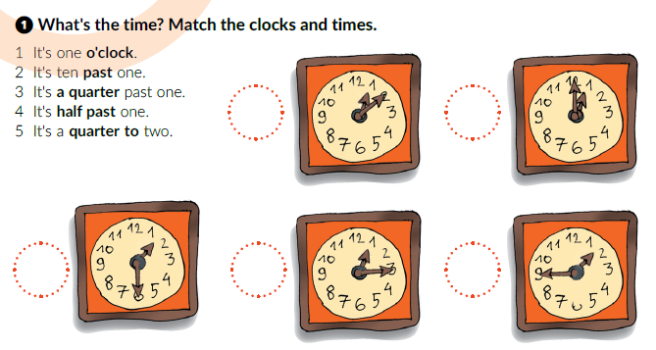
What’s the time?
When would you ask this question?
How did people tell time in the past?
3.00 – It’s three o’clock
3.30 – It’s half past three.
3.15 – It’s a quarter past three.
3.45 – It’s a quarter to four.
2
1
4
3
5

Slide 3
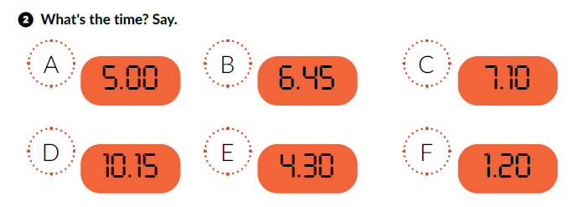

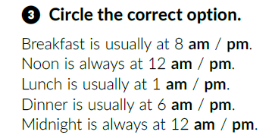
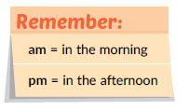
It’s five o’clock.
It’s a quarter to seven.
It’s ten past seven.
It’s a quarter past ten.
It’s half past four.
It’s twenty past one.
Click on the following link and choose Play and learn: What’s the time?
https://www.e-sfera.hr/dodatni-digitalni-sadrzaji/9cb21d2e-d3ed-4861-b209-42b3cd8c9ce1/

Slide 4
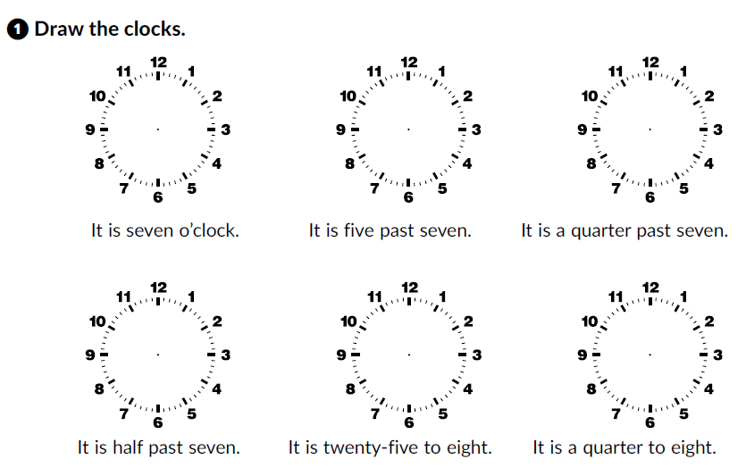
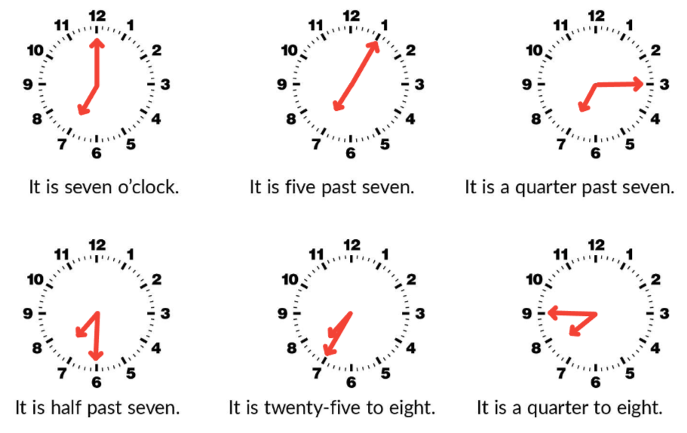
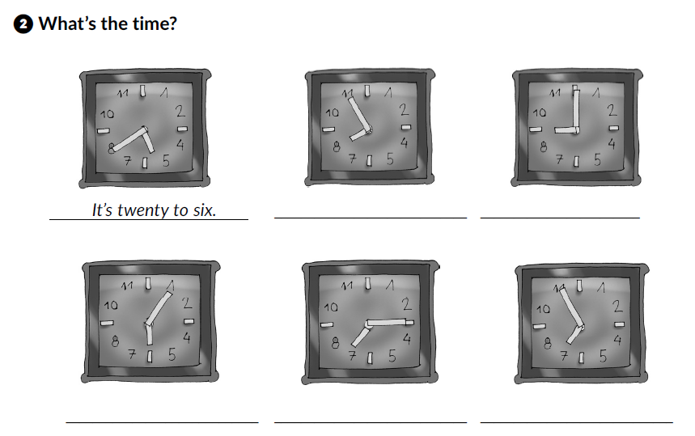
Workbook, p. 39
It’s five to eight.
It’s nine o’clock.
It’s five past six.
It’s a quarter past seven.
It’s five to seven.

Slide 5
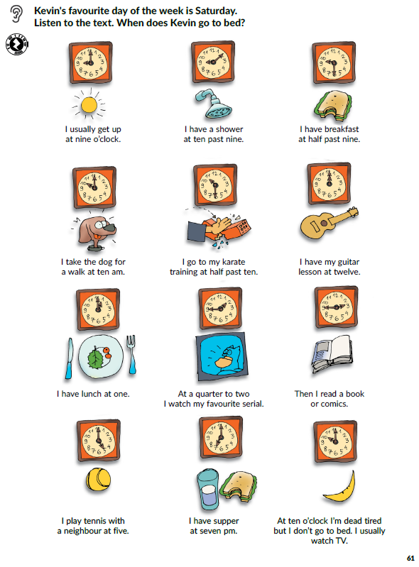

What do these words mean?
have a shower =
take a dog for a walk =
supper =
tired =
Listen and answer the question.
When does Kevin go to bed?
otuširati se
prošetati psa
večera
umoran

Slide 6
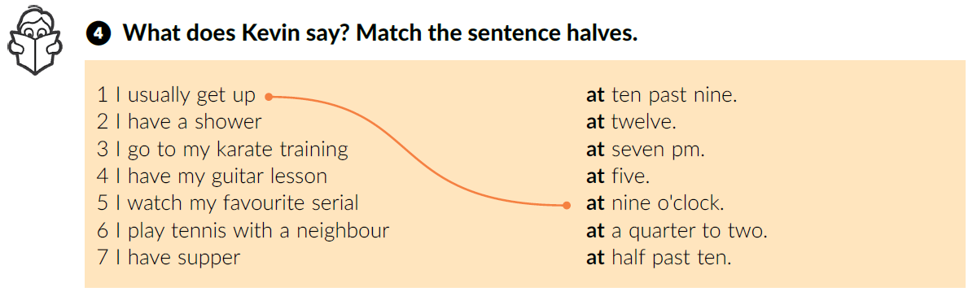
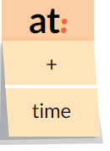
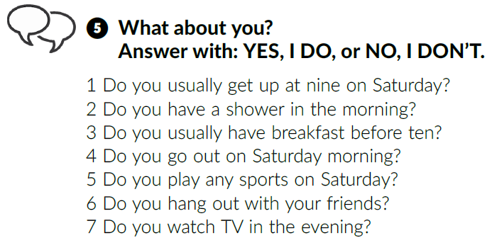
Listen again and match the sentence halves.
at ten past nine.
at half past ten.
at twelve.
at a quarter to two.
at five.
at seven pm.
Work in pairs.

Slide 7
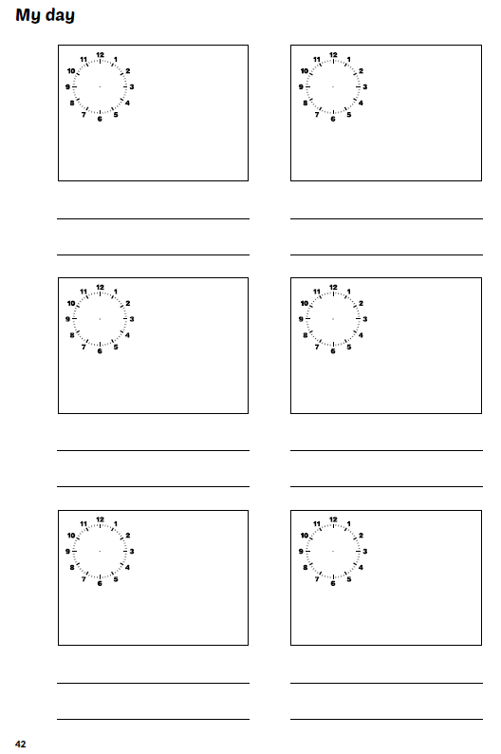
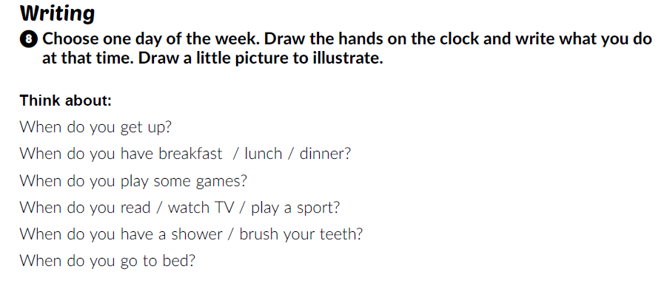
Workbook, p. 41-42
Read the instructions and describe your day.

Slide 8
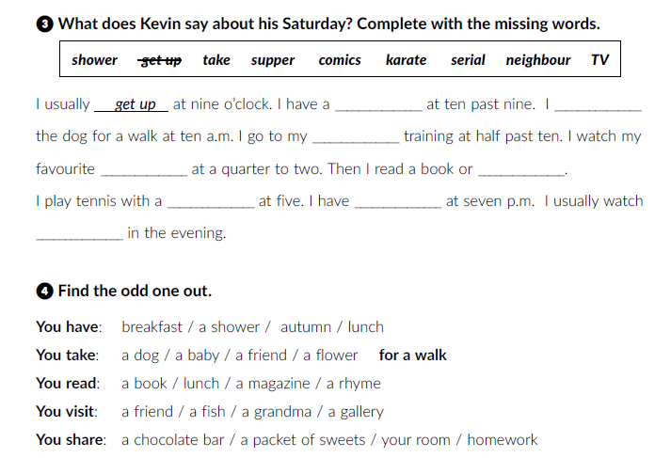
Workbook, p. 40
shower
take
karate
serial
comics
neighbour
supper
TV

Slide 9
Click on the following link and choose Learn more: A security guard’s day.
https://www.e-sfera.hr/dodatni-digitalni-sadrzaji/9cb21d2e-d3ed-4861-b209-42b3cd8c9ce1/
After that, click on Play and learn: Daily routine and complete the tasks.

Slide 10
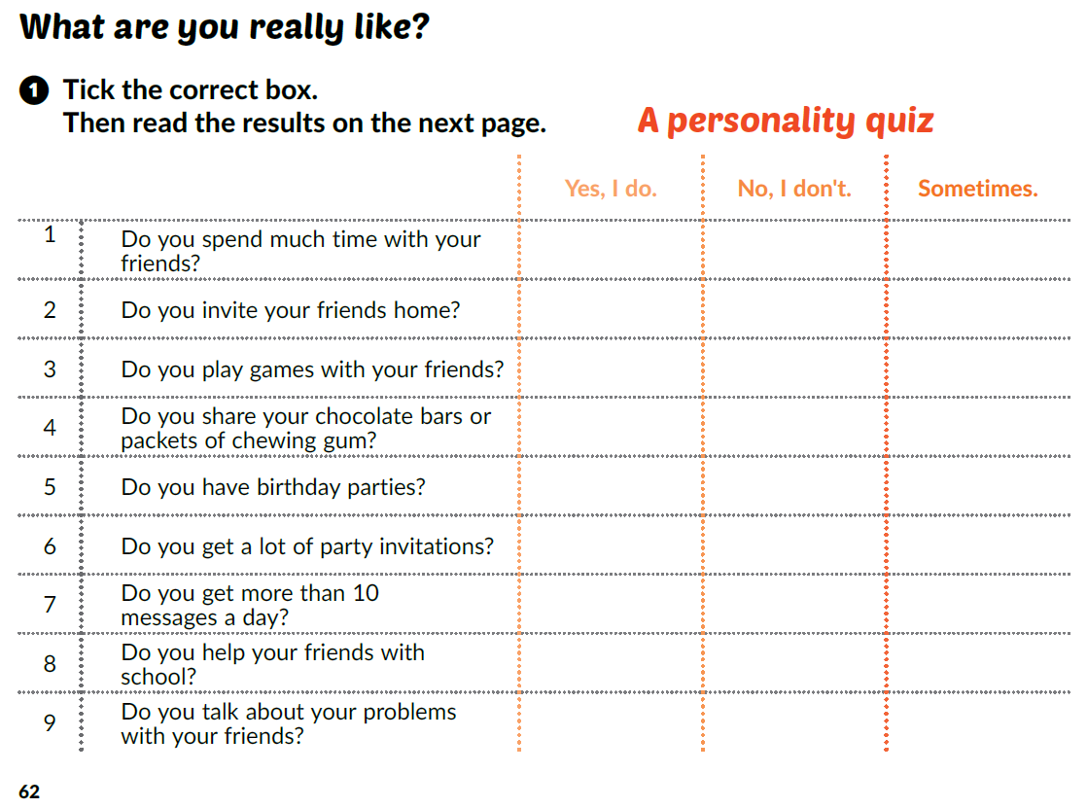
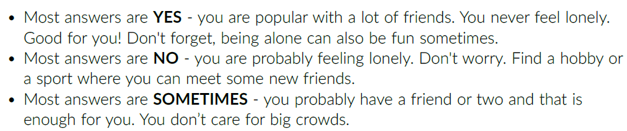
Translate:
invite =
invitation =
share =
pozvati
pozivnica
podijeliti

Slide 11
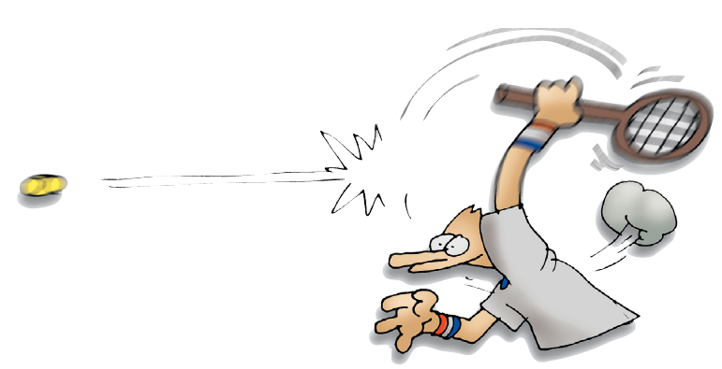
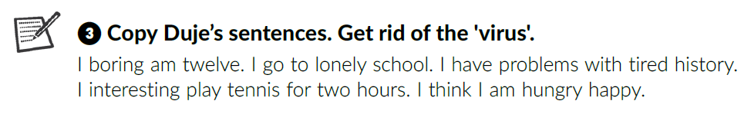
Do you do any sports?
Have you got many friends there?
Would you like to be a tennis champion?
Listen. Is Duje a happy boy?
Open your book at page 63.
Listen again and correct the sentences.
I am twelve.
I go to school.
I have problems with history.
I play tennis for two hours.
I think I am happy.

Slide 12
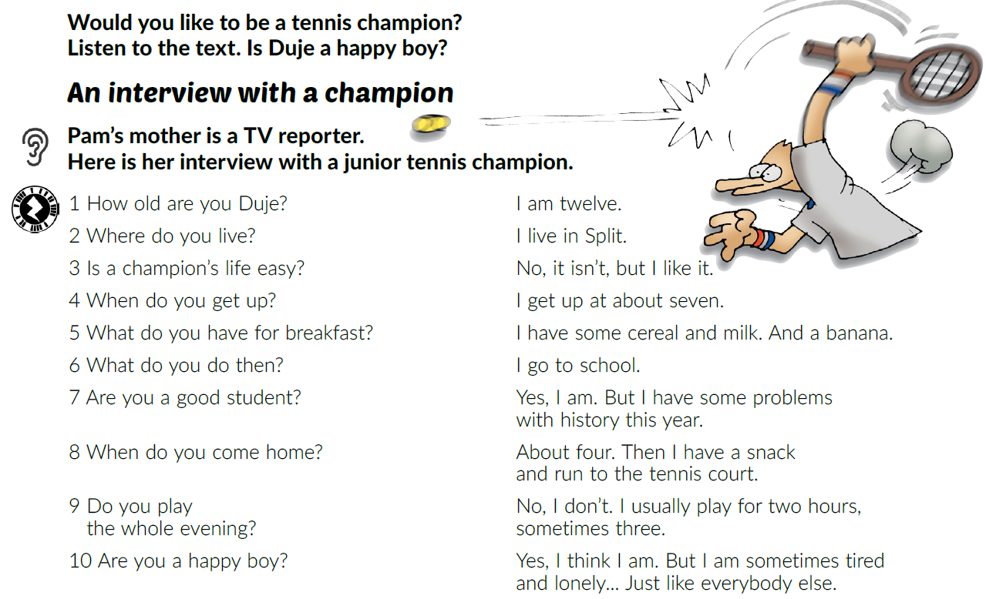
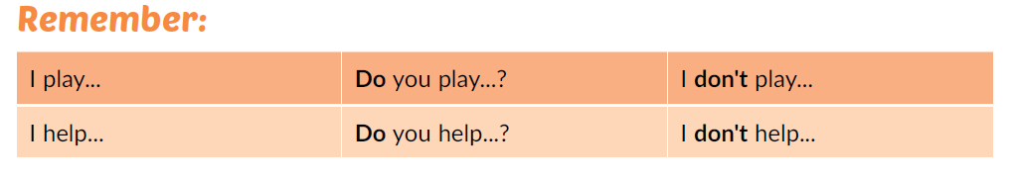
Read the dialogue out loud.
Translate:
How =
How old =
Where =
When =
What =
Kako
Koliko godina
Gdje
Kad
Što

Slide 13
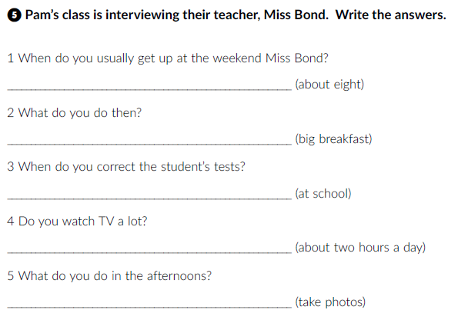
Work in pairs.
Choose a sportsperson that you would like to interview.
Imagine you’re a journalist and your partner is the chosen sportsperson. Write a dialogue. If you want, act out the dialogue.
I usually get up at about eight o’clock.
Workbook, p. 40 - 41
Then I have a big breakfast.
I correct them at school.
I watch TV for about two hours a day.
I take photos in the afternoons.

Slide 14
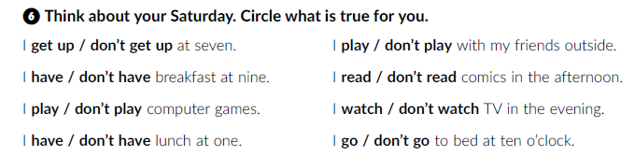
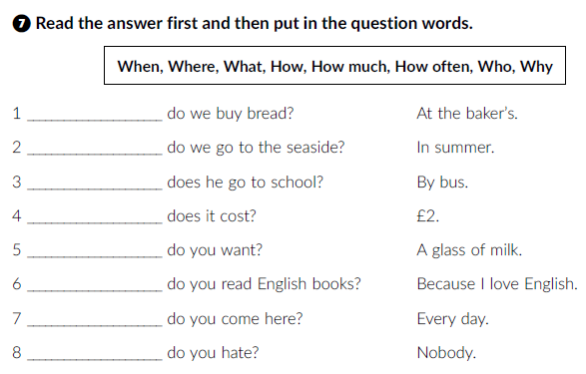
Where
When
How
How much
What
Why
How often
Who

Slide 15
Click on the following link and choose Play and learn: An interview and complete the tasks.
https://www.e-sfera.hr/dodatni-digitalni-sadrzaji/9cb21d2e-d3ed-4861-b209-42b3cd8c9ce1/

